Slide 1
OSA RMAD Dashboard

Slide 2
Functional Requirements
Ability to collect, store, transfer the data and messages (say 500 tags for a period of a year and then we xfer the data to a local drive)
Ability to perform simple math on the collected data (+, -, *, /, ratios, slopes, differentials, etc)
Ability to make simple user defined analysis, trending analyses and threshold alarms
Ability to make simple and complex dashboards for data presentation
Ability to send out alerts to designated parties

Slide 3
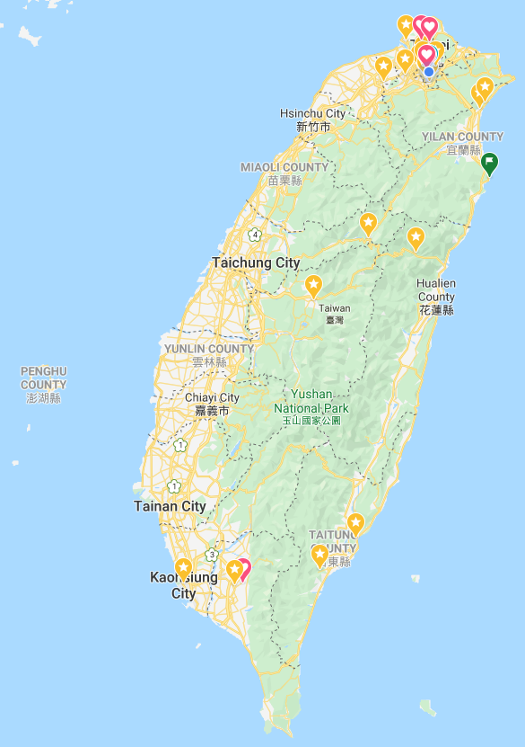

Main Page – Key Metrics
Operational Metrics | Unit | Value
Age since installation | yr | 3.1
Total operational hours | koph | 24,673
Average operational hours per year | koph/yr | 8,224
Hours since last stoppage | oph | 1,546
Warnings since last stoppage | count | 2
Faults since last stoppage | count | 0
Downtime per year | hrs | 10

Slide 4
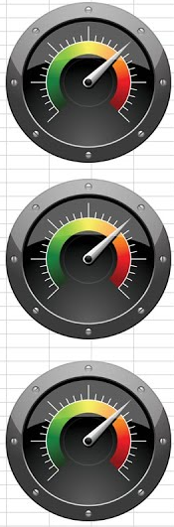
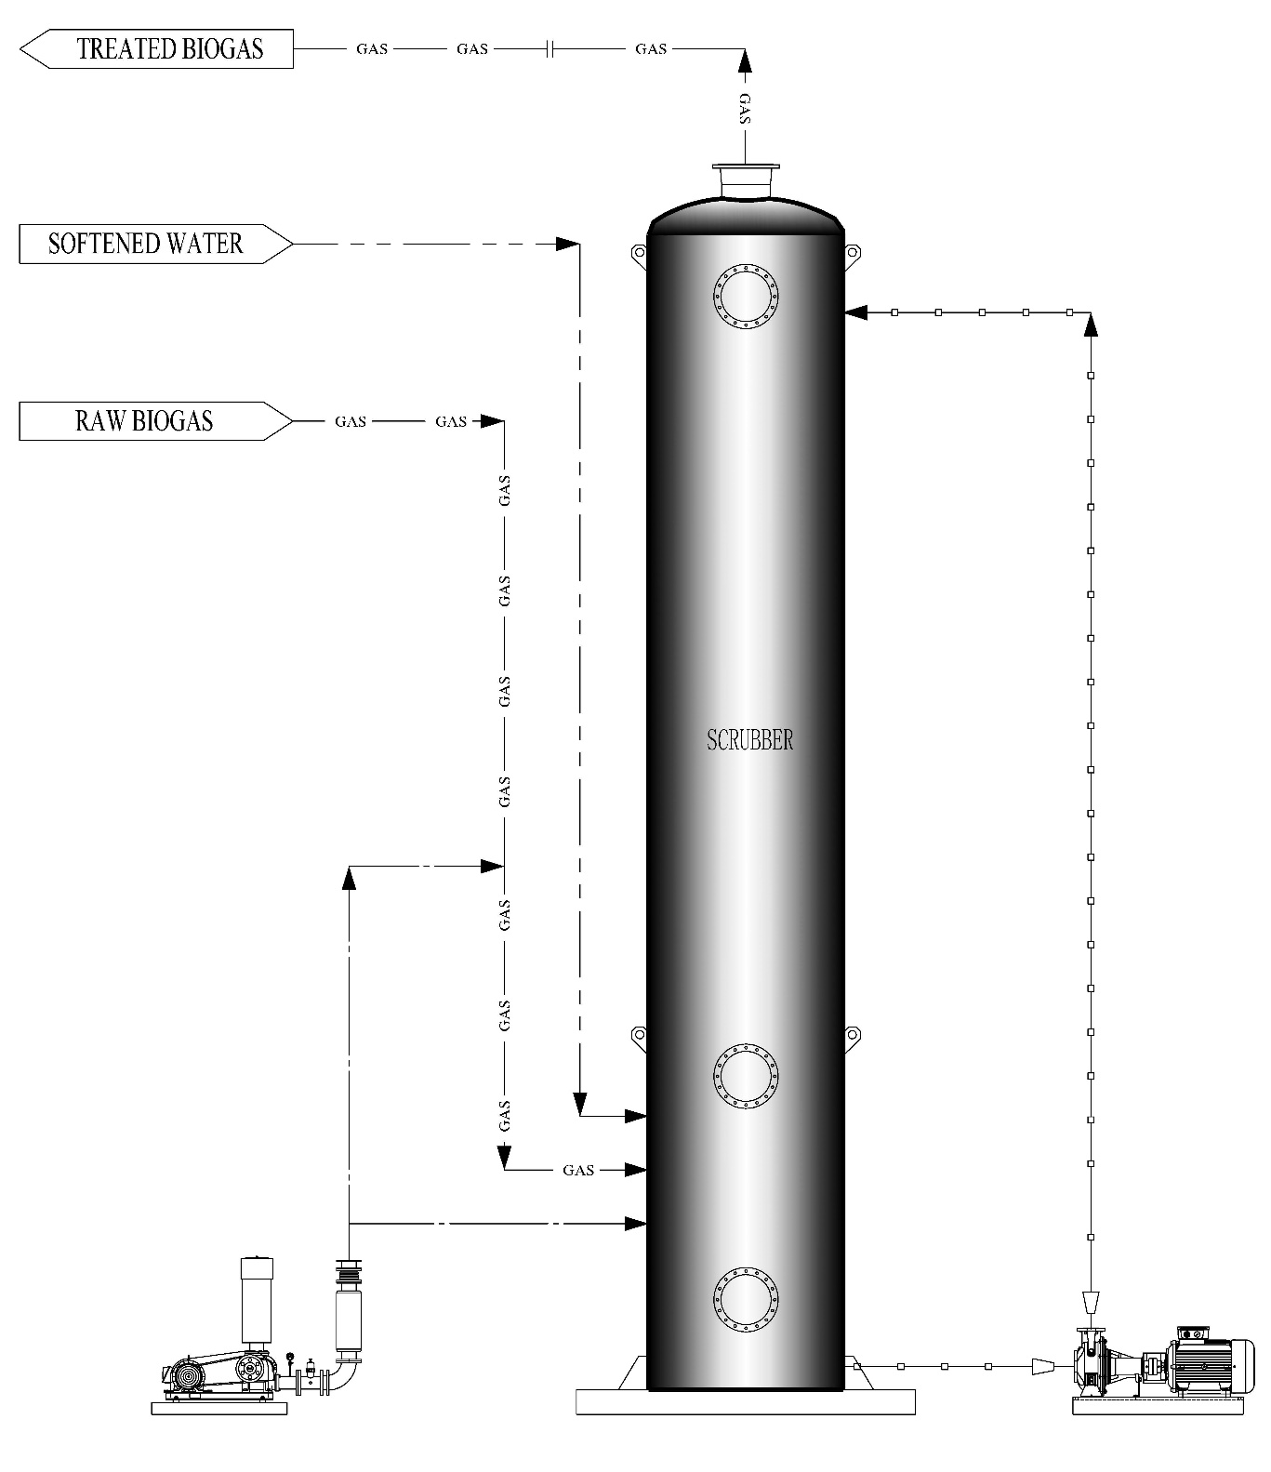
Hot Tags
Outlet
H₂S=100 ppm
O₂=2.5%
T=35°C
H₂S
100 ppm
pH
1.2
H₂S=4,500 ppm
O₂
2.5%
P_{pump}
2.6 bar
Temperature
35 °C
P_{blower}
3.0 bar
 | 系統運行 | 脫硫後硫化氫 | 填料 | 循環液pH | 循環泵 | 營養泵 | 營養液過濾器 | 軟水泵 | 鼓風機 | 沼氣中氧氣 | 沼氣溫度
正常
注意
警報
SV=36%
pH=1.2
P=2.6 bar
P=0.25 bar

Slide 5
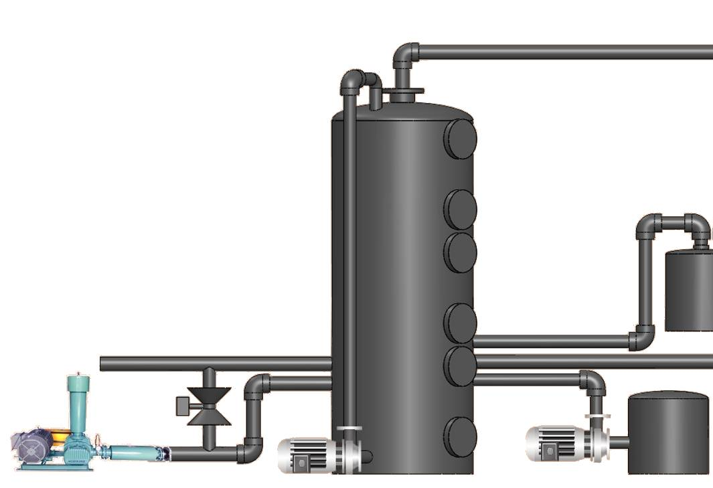

Hot Tags
 | 系統運行 | 脫硫後硫化氫 | 填料 | 循環液pH | 循環泵 | 營養泵 | 營養液過濾器 | 軟水泵 | 鼓風機 | 沼氣中氧氣 | 沼氣溫度
正常
注意
警報
Outlet
H₂S
100 ppm
Outlet biogas
H₂S=100 ppm
O₂=2.5%
T=35°C
O₂
2.5%
Circulation water
pH=1.2
P=2.6 bar
pH
1.2
Nutrient
P=2 bar
Temperature
35 °C
Inlet biogas
H₂S=4,500 ppm
P_{pump}
2.6 bar
Soft water
P=2 bar
SV=36%
Blower
P=0.25 bar
P_{blower}
3.0 bar

Slide 6
Hot Tags(Alarm)
 | 系統運行 | 脫硫後硫化氫 | 填料 | 循環液pH | 循環泵 | 營養泵 | 營養液過濾器 | 軟水泵 | 鼓風機 | 沼氣中氧氣 | 沼氣溫度
正常
注意
警報
Outlet
H₂S
100 ppm
Outlet biogas
H₂S=100 ppm
O₂=2.5%
T=35°C
O₂
2.5%
Circulation water
pH=1.2
P=2.6 bar
pH
1.2
Nutrient
P=2 bar
Temperature
35 °C
Inlet biogas
H₂S=4,500 ppm
P_{pump}
2.6 bar
Soft water
P=2 bar
SV=36%
Blower
P=0.25 bar
P_{blower}
3.0 bar

Slide 7
Data and Trending
Time | Pin (mbar) | Pout (mbar) | ΔP (mbar)
10 mbar
80% < ΔP < 100%
Backwash
8 mbar
50% < ΔP < 80%
Prepare for backwash
5 mbar
ΔP < 50%
Time
Notes:
Simple math: -
Ability setup alarm value: High and High High

Slide 8
Data and Trending
Time | pH | O₂ (%) | SV (%)
5%
80% < O₂ < 100%
Backwash
4%
60% < O₂ < 80%
Prepare for backwash
3%
O₂ < 60%
Time
Notes:
Simple math: slopes
Ability setup alarm value: High and High High

Slide 9
Data and Trending
Time | Nutrient Filter Pin (mbar) | Nutrient Filter Pout (mbar) | ΔP (mbar)
10 mbar
80% < ΔP < 100%
Clear
8 mbar
50% < ΔP < 80%
Prepare for Clear
5 mbar
ΔP < 50%
Time
Notes:
Simple math: -
Ability setup alarm value: High and High High

Slide 10
Data and Trending
Time | Circulation (bar) | Nutrient (bar) | Soft water (bar)
Pressure > 60%
1.2 bar
60% > pressure > 50%
Prepare for maintenance
50% > pressure > 40%
Maintenance
1.1 bar
1.0 bar
Time
Notes:
Ability setup alarm value: Low and Low

Slide 11
Data and Trending
Time | Temp (℃) | Environment Temp (℃)
Temp > 25℃
25℃
25℃ > Temp > 22℃
Prepare for Alarm
22℃ > Temp > 20℃
Alarm
22℃
20℃
Time
Notes:
Collection environment temperature from Central Weather Bureau
Ability setup alarm value: Low and Low

Slide 12
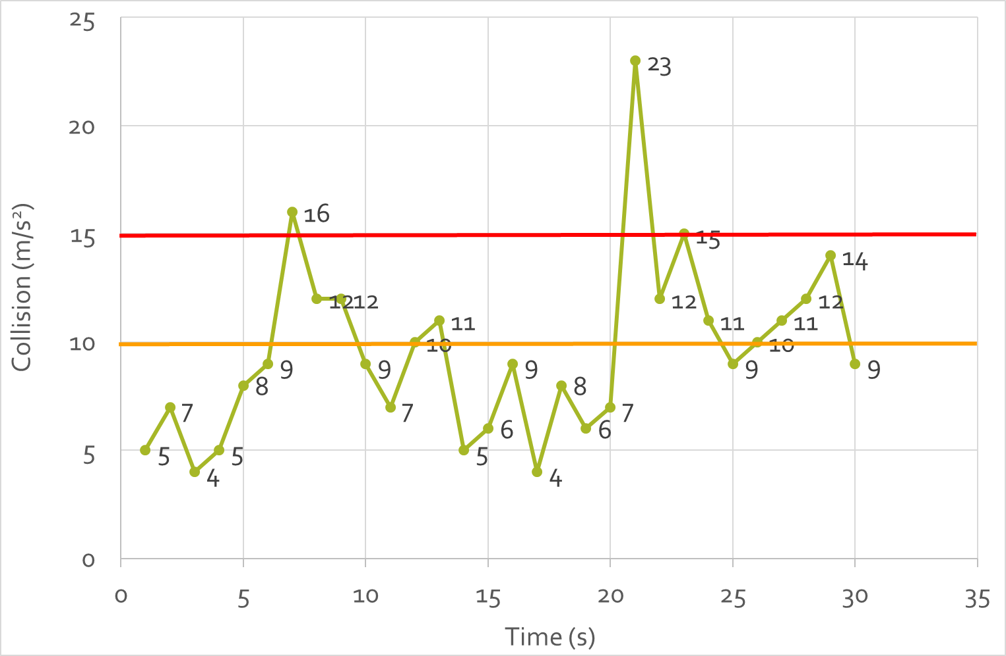
Event Logs, Warnings, Faults
Date & Time | EVENT | VALUE
10 December 2018, 17:51 | Monitoring ON
10 December 2018, 17:53 | pH warning | 1.0
14 December 2018, 6:45 | High H₂S | 100 ppm
14 December 2018, 8:45 | High H₂S | 135 ppm

